Slide 1



Progetto Reset
REinventing School Education Toward a digital world
Gamification as engaging learning methodology
Reinventing school education towards a digital world

Slide 2

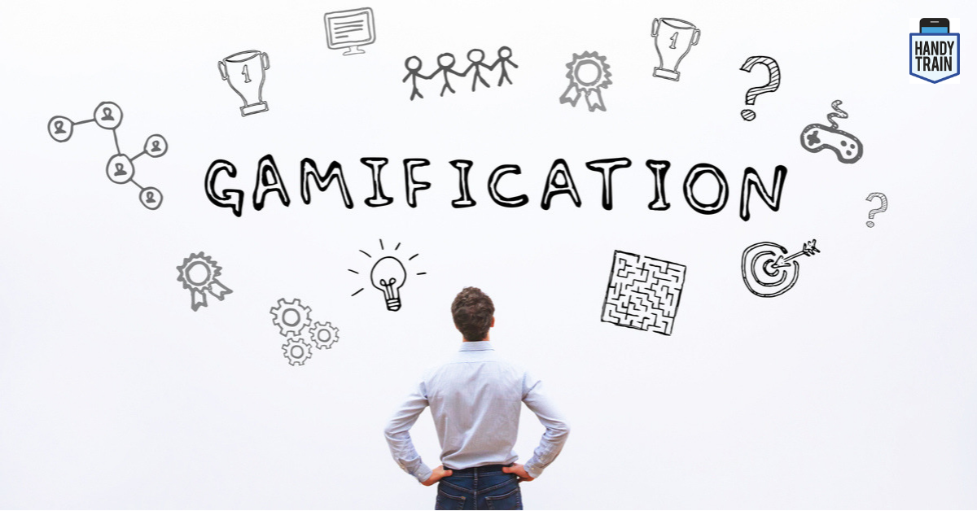



Gamification as engaging learning methodology
Let’s share our views
Education in the future: Gamification…
Genially: a platform for gamification
Let’s make knowledge
Let’s measure our knowledge
Let's create an application

Slide 3
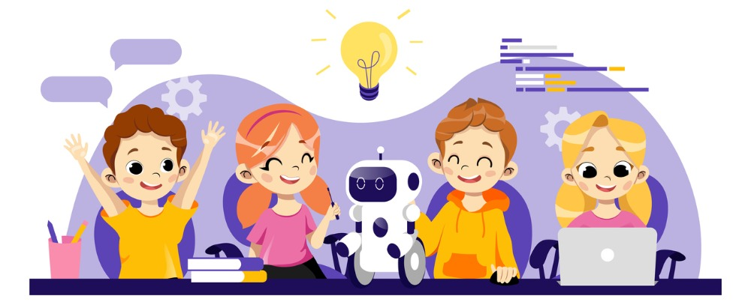
Education in the future: gamification, robots e blockchain
Source: INVALSI september 2021

Slide 4
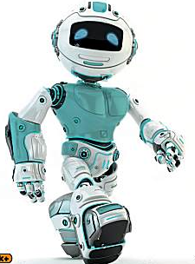
Robot e Robotics
The robot can be more useful in the learning process, instead of touch screen monitor, because it has greater gestures and interactivity that will be able to interface better with children..
Educational robotics, also called microrobotics, is a teaching method of robotics, which allows to learn through the creation of an educational robot, starting from scratch, through its programming and its development, passing through all stages of the process..

Slide 5
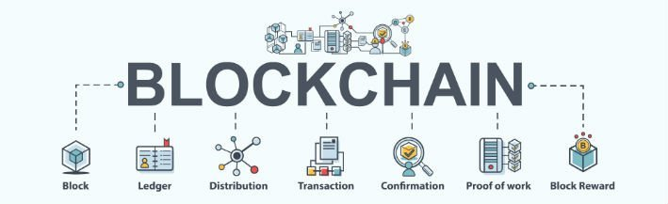
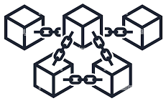
The Blockchain
We can describe it as a collection of digital information stored in blocks with limited storage capacity which, once filled, join other blocks thus forming a chain.
The data in the blocks, in fact, since they are all connected to each other and stored in a shared database, cannot be manipulated.

Slide 6
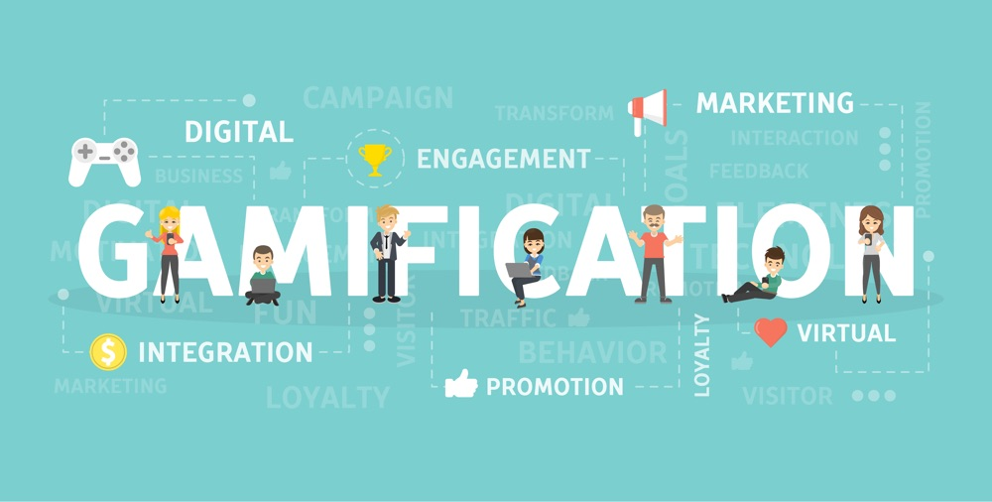

Slide 7

What’s Gamification?
Gamification is the use of elements borrowed from games and game design techniques in non-playful contexts, giving the freedom to reinvent a task by transforming it into a more fun and interactive experience.
Gamification is an activity, a practice, a process, it means doing something.
Gamification Uses game design and techniques borrowed from games.
Gamification is applied in non-playful contexts.
Gamification wants to motivate people to achieve their goals.

Slide 8
What is the purpose of gamification?
Gamifying is thinking, designing and relocating mechanics, dynamics and game elements in daily systems or processes with the aim of orienting oneself to solving concrete problems or, at the same time, to motivate children.

Slide 9

What is the function of gamification in the school environment?
Learn by playing! We can say that the game is the original form of our knowledge, it is probably our first tool for acquiring awareness and the main way of learning.
In fact, several studies confirm that play makes learning effective through three main elements:
Motivation
Interactivity
Involvement

Slide 10
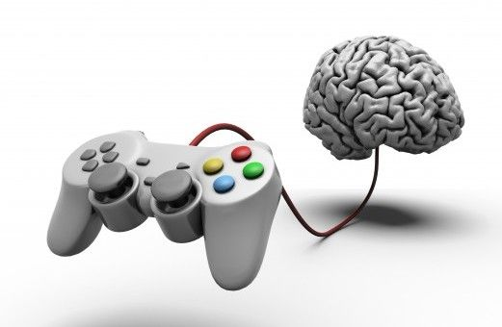
What happens while we play?
The game helps to focus and materialize on the goal. Video games are able to stimulate motivation, interest, creativity, a sense of belonging and happiness, feelings that become resources that can be immediately spent in daily activities.
The dynamics of the game allow people to immerse themselves in settings far from reality, catapulting the participant to take part in different challenges and choices in order to achieve the expected objectives.

Slide 11
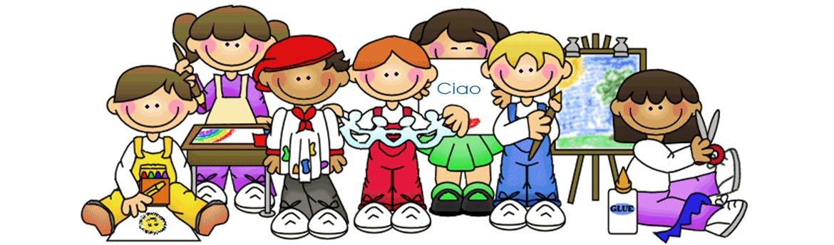
How to implement gamification in the classroom?
So let's see what are the main dynamics of the game to be applied to teaching in order to motivate pupils and allow them to memorize information in a meaningful and long-term way:
Segment the program into levels
Promote socialization and group works
Points, rankings and rules systems

Slide 12
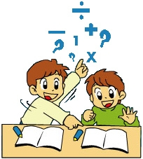
Segment the program into levels
Dividing the curriculum into many sub-phases stimulates students to move forward and to concretely solve problems.
In this way, the following needs are met
Growth
Self esteem
Activities
Still keeping high the degree of satisfaction and interest.

Slide 13

Promote socialization and group works
Socialization is a very important element for the gamification approach.
When we are faced with complicated “levels” we learn to collaborate and to put into practice the skills of each individual: in this way autonomy and self-control are also promoted.

Slide 14

Points, rankings and rules systems
Rewards fix behaviors much more than penalties.
The error should not be seen as discouraging, but as an impulse to try again and then obtain the right reward for the progressions.
The rules guarantee the impartiality of the context.

Slide 15
Keyword and four fixed points
The word "empathy" is perhaps the key to the whole game discourse, since the game, allows us to be the protagonists in the first person.
A challenge or goal that establishes what a person needs to accomplish.
Obstacles or impediments that must be overcome to achieve the goal.
Incentives or rewards students receive when they overcome obstacles and goals.
Game rules that define the student's interaction with the game and with other participants.

Slide 16
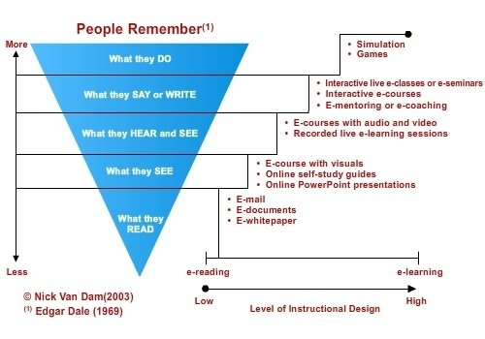

Slide 17

Critical issues in gamification
Consider gamification as a generalist attempt to transform serious contexts into playful ones.
Motivational drives are essentially based on external rewards, which may be less effective in the long term
The score could only be an incentive for a few pupils. For others it may be an additional reason for performance anxiety.
Failing to fully cover the demands of the school curricula.

Slide 18
Gamification does not replace the teacher's charisma
Gamification could be complementary training to teaching, but it may not be able to replace the charisma of a teacher, the only guarantee against school dropout and adolescent apathy.

Slide 19
Gamification as engaging learning methodology
Let’s share our views
Education in the future: Gamification…
Genially: a platform for gamification
Let’s make knowledge
Let’s measure our knowledge
Let's create an application

Slide 20
Andiamo su Kahoot.it ed inseriamo il codice

Slide 21
Gamification as engaging learning methodology
Let’s share our views
Education in the future: Gamification…
Genially: a platform for gamification
Let’s make knowledge
Let’s measure our knowledge
Let's create an application

Slide 22

Let’s go on https://genial.ly/

Slide 23
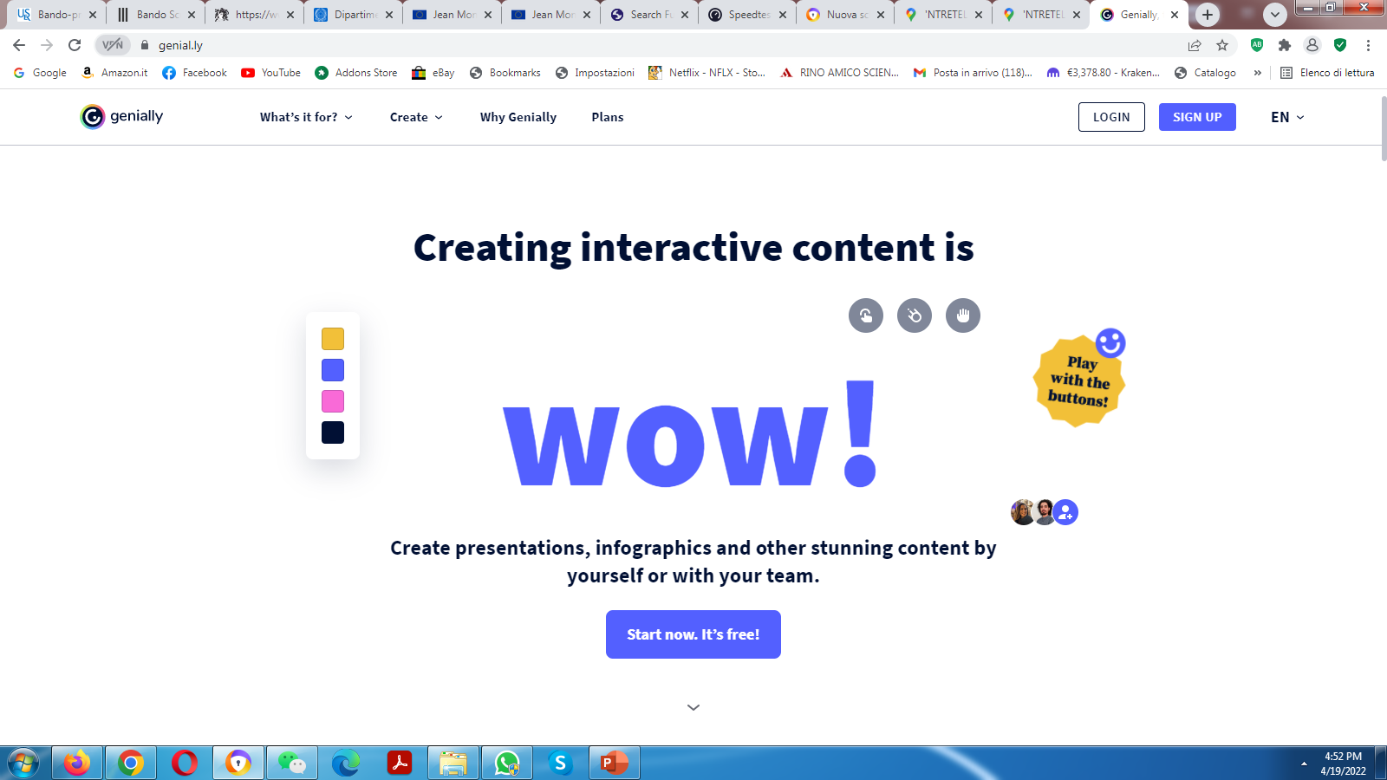
Click on the Login button at the top right
User: utente.prova@koinokalo.it
Password: Reset.01

Slide 24
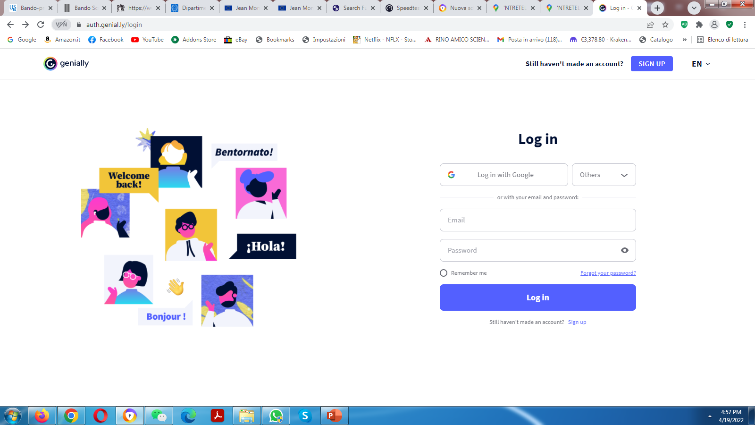
Enter your credentials and click the Login button
Utente: utente.prova@koinokalo.it
Password: Reset.01

Slide 25
Gamification as engaging learning methodology
Let’s share our views
Education in the future: Gamification…
Genially: a platform for gamification
Let’s make knowledge
Let’s measure our knowledge
Let's create an application

Slide 26
Let’s share our impressions ...
….

Slide 27
…
….

Slide 28
WHICH TOOLS CAN INNOVATE LEARNING?
The e-collaboration tools are ideal for allowing online collaboration in real time; the most popular are Google Drive and Drop Box. They are useful because they activate kids and allow them to make significant digital products. The direction that will be pursued in the training is the use of online software, often free, which allows to create collaboratively, rather than buying devices and hardware.

Slide 29
HOW WILL DIGITAL SKILLS INFLUENCE LEARNING?
Investing in digital skills means making people more free. Teaching how to exploit technology, not teaching how to do this or that. We have been using computers since time immemorial and we take many things for granted and acquired. But if you ask a student: where is the PC memory? What is his brain? How do you attach documents? What does that "https" that we see every day mean? 90% of people don't know what it means. But knowing that could make light bulbs turn on. We need to bring teachers and children back to basic digital culture, because knowing the basics means knowing how to choose the tools and therefore be independent and learn.

Slide 30
WHAT DID WE LEARN FROM THE PANDEMIC IN TERMS OF TRAINING AND LEARNING?
On the one hand, technologies allow training to continue even remotely, albeit often only in a compensatory way. On the other hand, however, the digital division has become evident: the exclusion of those who do not have tools, high-performance connections or networks. The experience of the pandemic has taught us that technology in itself is of little use, without the investment in digital skills of citizens, parents, pupils, but above all teachers. It is okay to suggest the use of digital tools to train and learn, but it is essential to tell people about the risks and potentials and teach them to self-train and self-update

Slide 31
Progetto Reset
REinventing School Education Toward a digital world
Gamification as engaging learning methodology
THANK YOU

